Slide 1
SOCIAL FINGERPRINTING: DETECTION OF SPAMBOT GROUPS THROUGH DNA-INSPIRED BEHAVIORAL MODELING
SOCIAL FINGERPRINTING: DETECTION OF SPAMBOT GROUPS THROUGH DNA-INSPIRED BEHAVIORAL MODELING
CLINT MATHEWS
Class No:22 S7 B-Tech CSE
Dept. of CSE,MACE Kothamangalam
October 2018

Slide 2
Contents
SOCIAL FINGERPRINTING: DETECTION OF SPAMBOT GROUPS THROUGH DNA-INSPIRED BEHAVIORAL MODELING
Introduction
Related work/Relevant Work
Datasets
Proposed Approach - Working
Analysis and Results
Proposed Approach – Advantages
Conclusion
References

Slide 3
Introduction
SOCIAL FINGERPRINTING: DETECTION OF SPAMBOT GROUPS THROUGH DNA-INSPIRED BEHAVIORAL MODELING
What is OSN?
Social Spambots
Online Behavioral Modeling
Social Fingerprinting

Slide 4
Introduction (contd…)
SOCIAL FINGERPRINTING: DETECTION OF SPAMBOT GROUPS THROUGH DNA-INSPIRED BEHAVIORAL MODELING
Spambot detection
Flexibility and applicability

Slide 5
Related work
SOCIAL FINGERPRINTING: DETECTION OF SPAMBOT GROUPS THROUGH DNA-INSPIRED BEHAVIORAL MODELING
Types of bots
Spammers
Bots
Cyborgs
Fake followers

Slide 6
Established techniques
SOCIAL FINGERPRINTING: DETECTION OF SPAMBOT GROUPS THROUGH DNA-INSPIRED BEHAVIORAL MODELING
Pruning rules and features
Detect Fake followers
Implementing classifier
Reduced over fitting
Cost of data gathering

Slide 7
Emerging Trends
SOCIAL FINGERPRINTING: DETECTION OF SPAMBOT GROUPS THROUGH DNA-INSPIRED BEHAVIORAL MODELING
Collective behavior
New generation of spam bots
Digital DNA
Study of groups

Slide 8
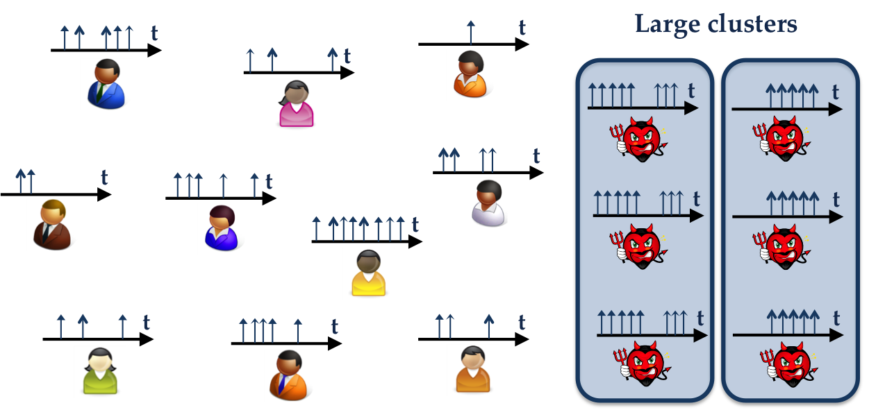
Emerging Trends(contd…)
SOCIAL FINGERPRINTING: DETECTION OF SPAMBOT GROUPS THROUGH DNA-INSPIRED BEHAVIORAL MODELING
SynchroTrap
(Courtesy: https://users.cs.duke.edu/~qiangcao/synchrotrap_project/pics/synchrotrap_overview_2.png)

Slide 9
Comparison
SOCIAL FINGERPRINTING: DETECTION OF SPAMBOT GROUPS THROUGH DNA-INSPIRED BEHAVIORAL MODELING
Sequence of characters encoding accounts
Reduced cost of data gathering
Timeline data
DNA inspired modeling

Slide 10
Twitter Datasets
SOCIAL FINGERPRINTING: DETECTION OF SPAMBOT GROUPS THROUGH DNA-INSPIRED BEHAVIORAL MODELING
Real world data
Two different family of spam bots
Mayoral election spambots
Ecommerce spambots
Social engineering

Slide 11
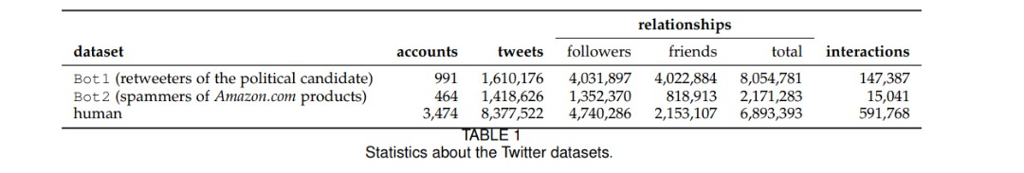
Twitter Datasets(contd…)
SOCIAL FINGERPRINTING: DETECTION OF SPAMBOT GROUPS THROUGH DNA-INSPIRED BEHAVIORAL MODELING
Twitter crawler
Classification of bots and humans
(Courtesy: https://ieeexplore.ieee.org/document/7436643/table1.jpg)

Slide 12
Digital DNA
SOCIAL FINGERPRINTING: DETECTION OF SPAMBOT GROUPS THROUGH DNA-INSPIRED BEHAVIORAL MODELING
DNA sequence
DNA strand
Sequence database
Analysis Techniques –Repetition

Slide 13
Digital DNA(contd…)
SOCIAL FINGERPRINTING: DETECTION OF SPAMBOT GROUPS THROUGH DNA-INSPIRED BEHAVIORAL MODELING
Digital DNA to model OSN users
Flexibility
Number and meaning of bases
Twitter digital DNA concept

Slide 14
Definition of digital DNA sequence
SOCIAL FINGERPRINTING: DETECTION OF SPAMBOT GROUPS THROUGH DNA-INSPIRED BEHAVIORAL MODELING
Bases used to create digital DNA sequence
B = {B₁,B₂,B₃,…,B_{N}} B_{i} ≠B i , j=1,…,N and i ≠ j
Cardinality N=|B|
DNA sequence encodes action
s=(b₁,b₂,b₃,…,b_{n}) b_{i} € B i=1,…,n and n=|s|

Slide 15
Digital DNA (contd....)
SOCIAL FINGERPRINTING: DETECTION OF SPAMBOT GROUPS THROUGH DNA-INSPIRED BEHAVIORAL MODELING
B³_{type} =
A ← tweet,
C ← reply,
T ← retweet
={A,C,T}
DNA sequence of above type
s={A,A,A,C,A,T,C,A,A,C,…}

Slide 16
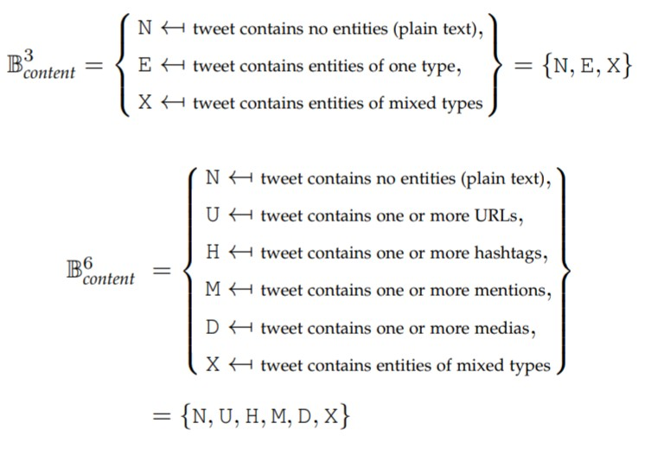
Digital DNA (contd....)
SOCIAL FINGERPRINTING: DETECTION OF SPAMBOT GROUPS THROUGH DNA-INSPIRED BEHAVIORAL MODELING
(Courtesy: https://ieeexplore.ieee.org/document/7436643/dna.jpg)

Slide 17

LCS
SOCIAL FINGERPRINTING: DETECTION OF SPAMBOT GROUPS THROUGH DNA-INSPIRED BEHAVIORAL MODELING
Similarity measure for digital DNA sequences
K-common substring problem
Monoatomic non increasing functions
LCS[k-1] ≥ LCS[k] ∀ 3≤ k $≤M$

Slide 18
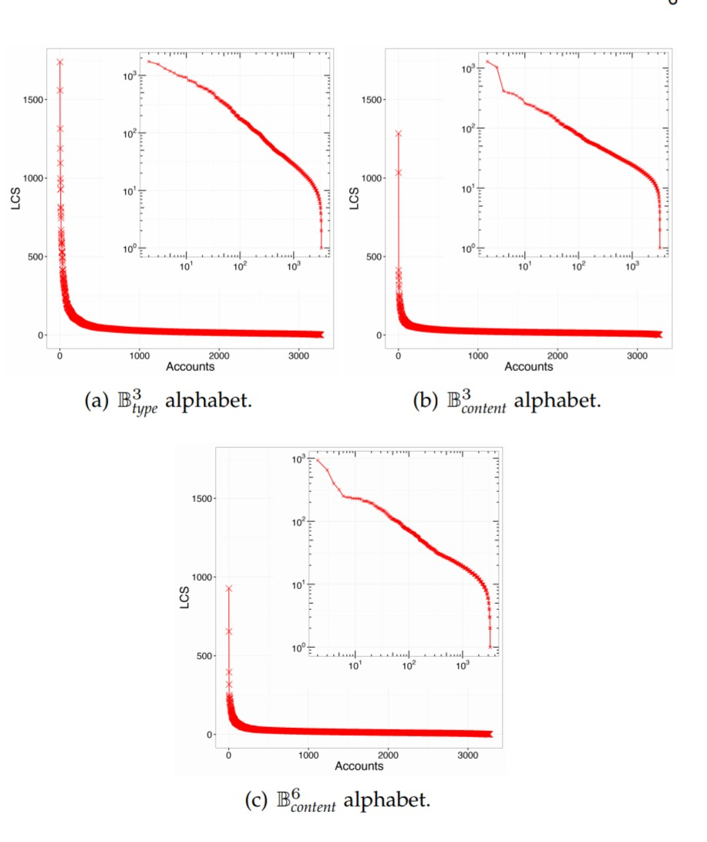
LCS (contd…)
SOCIAL FINGERPRINTING: DETECTION OF SPAMBOT GROUPS THROUGH DNA-INSPIRED BEHAVIORAL MODELING
(Courtesy: https://ieeexplore.ieee.org/document/7436643/lcs.jpg)

Slide 19
Characterization of DNAs with LCS curves
SOCIAL FINGERPRINTING: DETECTION OF SPAMBOT GROUPS THROUGH DNA-INSPIRED BEHAVIORAL MODELING
Distinction between genuine users and spambots
LCS curves of datasets
Sudden drop in LCS curves
High value of LCS
High level of similarity

Slide 20
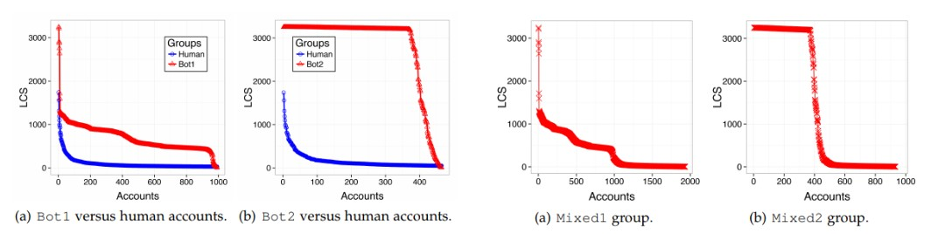
LCS Curves of Heterogeneous Users
SOCIAL FINGERPRINTING: DETECTION OF SPAMBOT GROUPS THROUGH DNA-INSPIRED BEHAVIORAL MODELING
(Courtesy: https://ieeexplore.ieee.org/document/7436643/homohetro.jpg)

Slide 21
Social Fingerprinting
SOCIAL FINGERPRINTING: DETECTION OF SPAMBOT GROUPS THROUGH DNA-INSPIRED BEHAVIORAL MODELING
Supervised and an unsupervised approach
Spambots related to high LCS values
Long behavioral patterns

Slide 22
Supervised Approach
SOCIAL FINGERPRINTING: DETECTION OF SPAMBOT GROUPS THROUGH DNA-INSPIRED BEHAVIORAL MODELING
Discriminate between genuine users and spambots
Training-set , Test-set
Splitting point in the LCS curves
Classifier evaluated using ROC curves
Transfer learning

Slide 23
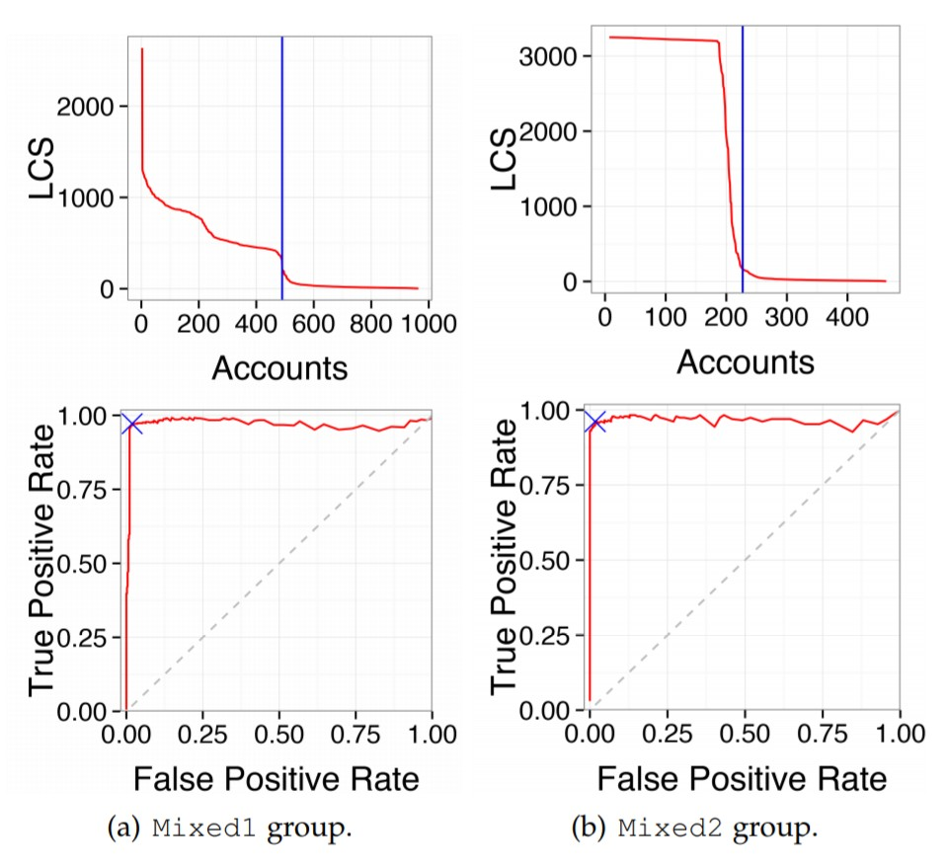
Supervised Approach(contd…)
SOCIAL FINGERPRINTING: DETECTION OF SPAMBOT GROUPS THROUGH DNA-INSPIRED BEHAVIORAL MODELING
(Courtesy: https://ieeexplore.ieee.org/document/7436643/supervised.jpg)

Slide 24

Unsupervised Approach
SOCIAL FINGERPRINTING: DETECTION OF SPAMBOT GROUPS THROUGH DNA-INSPIRED BEHAVIORAL MODELING
Leverages previous findings
Discrete derivative of a LCS curve
Steep drops corresponds to splitting point
Sharp negative peeks in LCS’
Smoothed LCS curves, low pass filter
(Courtesy: https://ieeexplore.ieee.org/document/7436643/logderlcs.jpg)

Slide 25
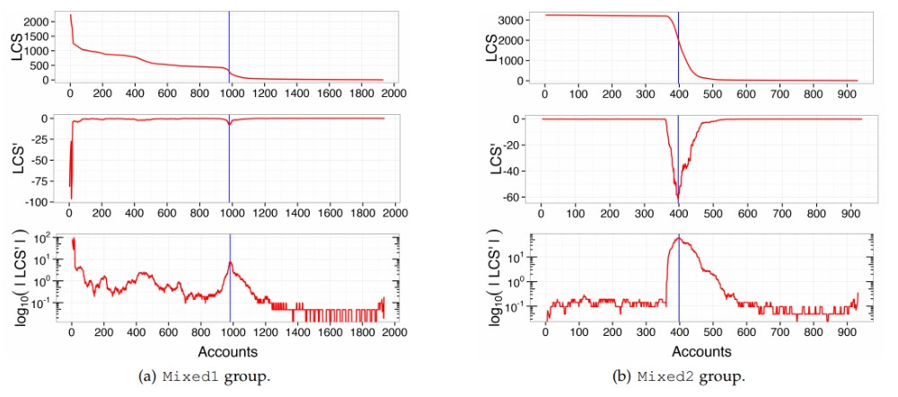
Unsupervised Approach(contd…)
SOCIAL FINGERPRINTING: DETECTION OF SPAMBOT GROUPS THROUGH DNA-INSPIRED BEHAVIORAL MODELING
(Courtesy: https://ieeexplore.ieee.org/document/7436643/unstructured.jpg)

Slide 26
Comparison
SOCIAL FINGERPRINTING: DETECTION OF SPAMBOT GROUPS THROUGH DNA-INSPIRED BEHAVIORAL MODELING
Steep drops of LCS curves
Similar splitting thresholds
Evaluation metrics based on
True Positive
True Negative
False Positive
False Negative

Slide 27
Comparison (contd…)
SOCIAL FINGERPRINTING: DETECTION OF SPAMBOT GROUPS THROUGH DNA-INSPIRED BEHAVIORAL MODELING
Confusion matrix
Standard Evaluation metrics
Precision
Recall
Specificity
Accuracy
F-Measure
Matthews Correlation Coefficient

Slide 28
Discussion
SOCIAL FINGERPRINTING: DETECTION OF SPAMBOT GROUPS THROUGH DNA-INSPIRED BEHAVIORAL MODELING
State of the art spam bot detection algorithm
Supervised approach by Yang et al
Relationships
Tweeting time
Level of automation
Unsupervised approaches by Miller et al and Ahmed et al

Slide 29
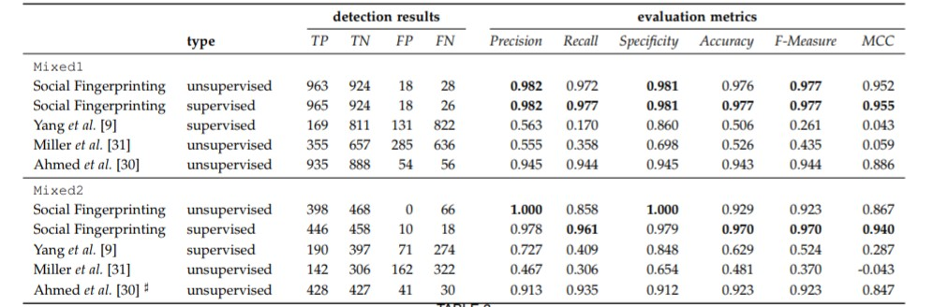
Discussion(contd…)
SOCIAL FINGERPRINTING: DETECTION OF SPAMBOT GROUPS THROUGH DNA-INSPIRED BEHAVIORAL MODELING
(Courtesy: https://ieeexplore.ieee.org/document/7436643/discussion.jpg)

Slide 30
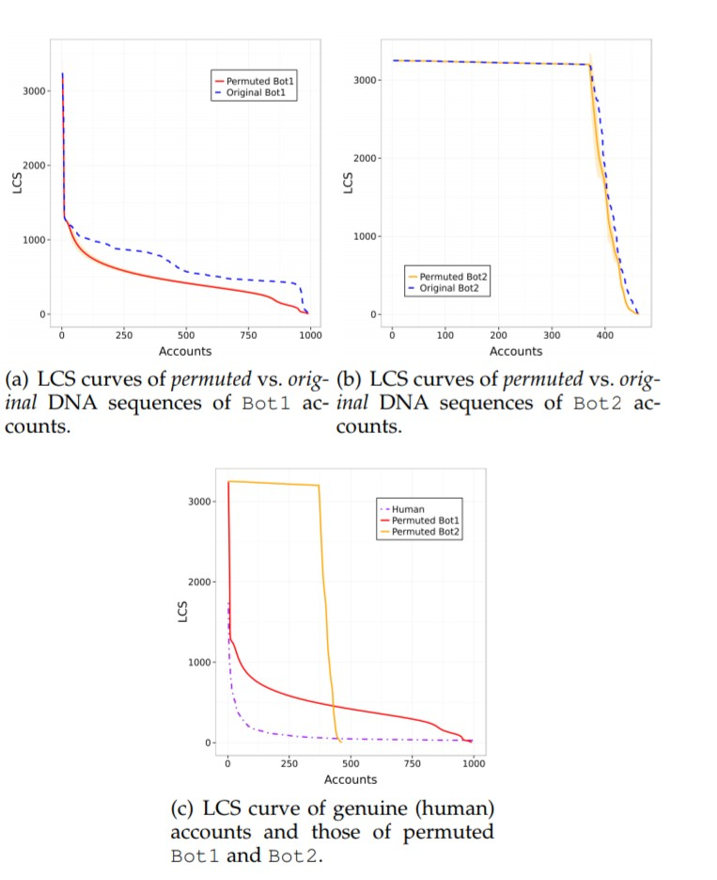
Flexibility
SOCIAL FINGERPRINTING: DETECTION OF SPAMBOT GROUPS THROUGH DNA-INSPIRED BEHAVIORAL MODELING
Multiple types of digital DNA
Monte Carlo Simulation
(Courtesy: https://ieeexplore.ieee.org/document/7436643/permutation.jpg)

Slide 31
Conclusion
SOCIAL FINGERPRINTING: DETECTION OF SPAMBOT GROUPS THROUGH DNA-INSPIRED BEHAVIORAL MODELING
Spam bots mimic human behavior
Novel spam bots escape state of the art algorithms
Digital DNA behavioral modeling

Slide 32
References
SOCIAL FINGERPRINTING: DETECTION OF SPAMBOT GROUPS THROUGH DNA-INSPIRED BEHAVIORAL MODELING
[1] H. Liu et al., “Uncovering deception in social media,” Social Network Analysis and Mining, vol. 4, no. 1, pp. 1–2, 2014.
[2] G. Stringhini, M. Egele, C. Kruegel, and G. Vigna, “Poultry markets: on the underground economy of Twitter followers, "in Online Social Networks. ACM, 2012, pp. 1–6.
[3] G. Stringhini, G. Wang, M. Egele, C. Kruegel, G. Vigna, H. Zheng, and B. Y. Zhao, “Follow the green: growth and dynamics in Twitter follower markets,” in Internet Measurement Conference (IMC). ACM, 2013, pp. 163–176.
[4] K. Thomas, D. McCoy, C. Grier, A. Kolcz, and V. Paxson, “Trafﬁcking fraudulent accounts: The role of the underground market in Twitter spam and abuse,” in 22nd USENIX Security Symposium, 2013, pp. 195–210.
[5] K. Lee, J. Caverlee, and S. Webb, “Uncovering social spammers: social honeypots + machine learning,” in 33rd Research and Development in Information Retrieval. ACM, 2010, pp. 435–442.

Slide 33
References (contd…)
SOCIAL FINGERPRINTING: DETECTION OF SPAMBOT GROUPS THROUGH DNA-INSPIRED BEHAVIORAL MODELING
[6] G. Stringhini, C. Kruegel, and G. Vigna, “Detecting spammers on social networks,” in 26th Annual Computer Security Applications Conference (ACSAC). ACM, 2010, pp. 1–9.
[7] S. Fortunato, “Community detection in graphs,” Physics Reports, vol. 486, no. 3, pp. 75–174, 2010.
[8] S. Ghosh, B. Viswanath, F. Kooti, N. K. Sharma, G. Korlam, F. Benevenuto, N. Ganguly, and K. P. Gummadi, “Understanding and combating link farming in the Twitter social network,” in 21st World Wide Web. ACM, 2012, pp. 61–70
. [9] C. Yang, R. Hark reader, and G. Gu, “Empirical evaluation and new design for ﬁghting evolving Twitter spammers,” IEEE Trans. Information Forensics and Security, vol. 8, no. 8, pp. 1280–1293, 2013. [10] X. Hu, J. Tang, and H. Liu, “Online social spammer detection,” in 28th AAAI Conference on Artiﬁcial Intelligence, 2014.

Slide 34
THANK YOU
SOCIAL FINGERPRINTING: DETECTION OF SPAMBOT GROUPS THROUGH DNA-INSPIRED BEHAVIORAL MODELING

